Slide 1
Literature review for “Closing the AI Accountability Gap” (Raji et al. 2020)
2020.12

Slide 2
Outlines
Overview
Highlights

Slide 3
The problem
It remains challenging to identify the harmful repercussions of the system before deployment. Once deployed, issues can become difficult to trace back.
AI industry lacks proven methods to translate principles into practice
Some AI principle examples:
AI are subject to human control
Avoiding the creation of unfair bias
External audit
Internal audit
Identify risks from outside
Conducted after deployment
Operate within the context
Inform when risk outweigh the benefits

Slide 4
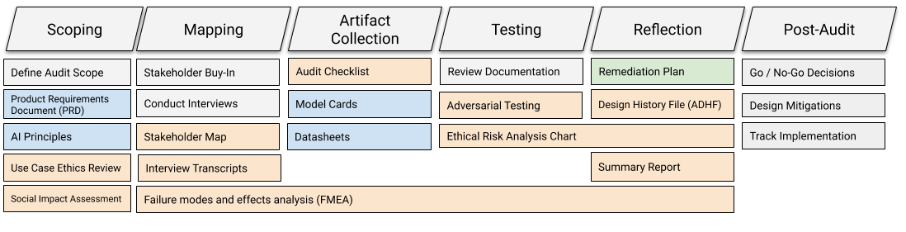
Solution
An internal algorithmic audits as a mechanism called SMACTR, across creation and deployment.
Figure 1: SMACTR framework (Raji et al. 2020)
Orange documents are produced by auditors, blue documents are produced by the engineering,
Green documents are produced by both teams

Slide 5
Lessons from other industries
Aerospace - remarkable safety record
Design checklists
Traceability
Failure modes and effect analysis (FMEA)
Medical devices - audits are a daily occurrence
Design controls
Intended use
Design history file
Structural vulnerability
Finance – financial auditing
Audit infrastructure

Slide 6
Lessons from other industries
Combine with waterfall or verification-and-validation approach
Documentation-oriented
Auditable
Requirements-driven
Risk-based approach
Explicit documentation about the purpose, data, model, risks
Assess practices against the scope of the audit
Standardization

Slide 7
The approach
The scoping stage
Input:
A product/request documents
AI principles
Artifact:
Ethical review of system use case
Social Impact Assessment
The mapping stage
Artifact:
Stakeholder map
Ethnographic field study

Slide 8
The approach
The artifact collection stage
Artifact:
Design checklist
Model card
How the model was built
What assumptions in development (scope)
What type of model behavior might be experienced by different data (risk)
Intended use of the model
Evaluation data
Datasheets
Data collection process

Slide 9
The approach
The testing stage
Artifact:
Adversarial testing
Update FMEA with the results
Executed in both pre-release and post-launch
Ethical risk analysis chart
Considers the likelihood and the severity of a failure

Slide 10
The approach
The reflection stage
Artifact:
Mitigation/Action plan, developed by both audit and engineering teams
Algorithmic use-related risk analysis and FMEA
Algorithmic Design History File (ADHF)
Algorithmic Audit Summary Report

Slide 11
Highlights
Companies needs audit to understand the dynamics of their systems, and to manage the impact.
Internal audit in this case, as it:
operate within the development context
inform when risks outweigh the benefits before deployment

Slide 12
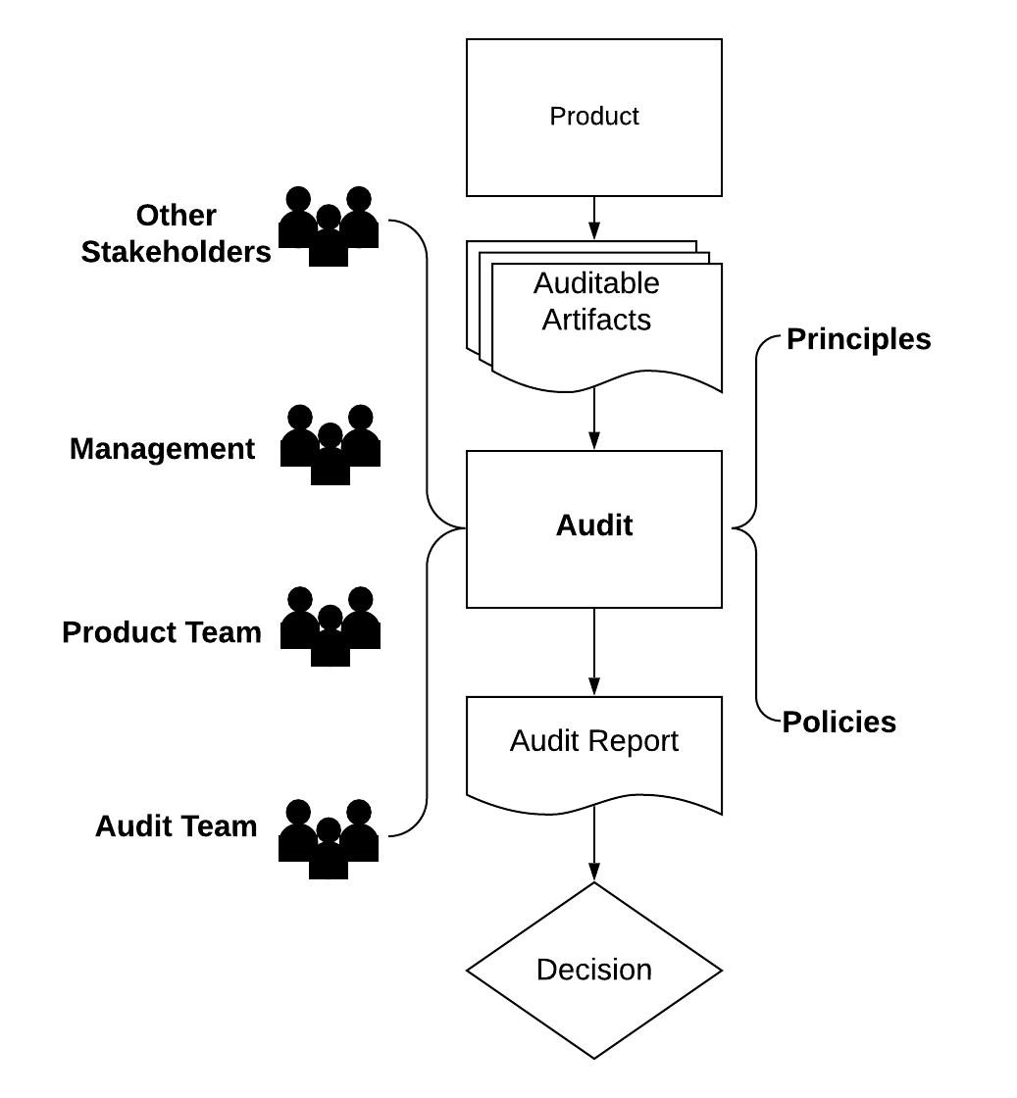
Highlights
An end-to-end standard process for internal auditing
Figure 2: High-level overview of the context of an internal audit (Raji et al. 2020)

Slide 13
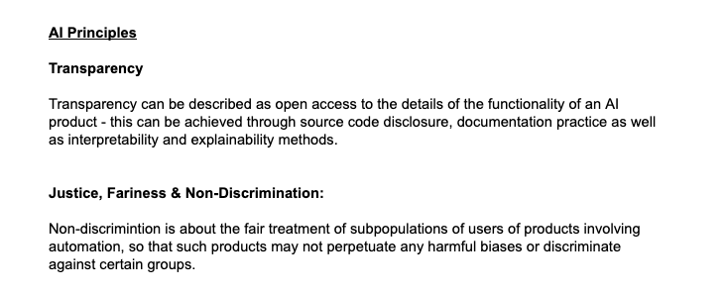
Highlights
The document provided by engineering team can be used as a guidance for the team later
Figure 3: An sample A.I. principle document (Raji et al. 2020)

Slide 14
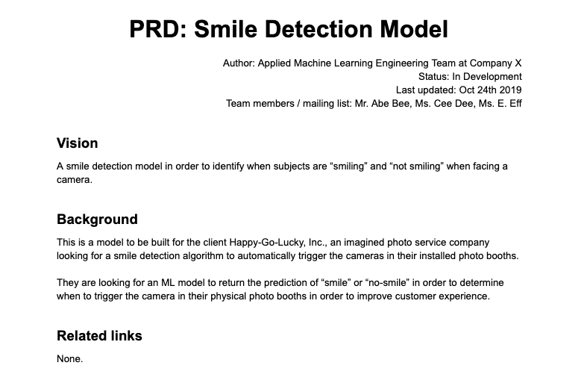
Highlights
The document provided by engineering team can be used as a guidance for the team later
Figure 4: An sample PRD (Raji et al. 2020)

Slide 15
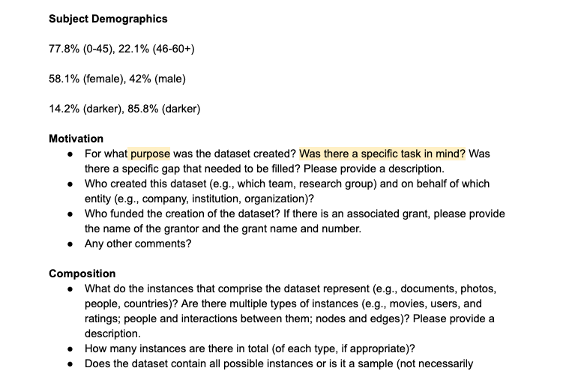
Highlights
Datasheet and model card ensure the quality and reproducibility of the model
Figure 5: An sample datasheet (Raji et al. 2020)

Slide 16
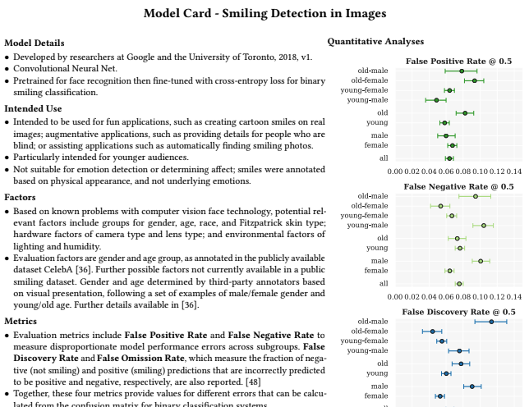
Highlights
Datasheet and model card ensure the quality and reproducibility of the model
Figure 6: An sample model card (Raji et al. 2020)

Slide 17
Limitation
Internal audits are only one aspect for quality check
Audits need to understand context, and maintain an independent and objective viewpoint at the same time

Slide 18
Reference
Raji, I. D. et al. (2020) ‘Closing the AI Accountability Gap: Defining an End-to-End Framework for Internal Algorithmic Auditing’, arXiv:2001.00973 [cs]. Available at: http://arxiv.org/abs/2001.00973 (Accessed: 17 November 2020).

